Slide 1
Progress Report Visual Perception
Date: 2021/01/13
Presenter: Bing-Jhang Lin
Advisor: Prof. Li-Chen Fu

Slide 2
Outline
Approach
Introduction
Multi-task learning framework
Detection algorithm for mental disorder
Results on public benchmarks
Demo Videos

Slide 3
Approach – Introduction
Schizoaffective disorder is a chronic mental health condition that involves symptoms of both schizophrenia and a mood disorder like Depression disorder or Bipolar disorder.
Bipolar disorder is an unstable emotional condition characterized by cycles of abnormal, persistent high mood, and low mood.
Depression disorder is a low emotional state.
These disorders are highly related to emotion and depression.
Previous studies consider facial analysis to infer the mental state of human.

Slide 4
Approach – Introduction
Conventional Facial Expression Recognition systems often fail to estimate the mental state of people.
Emotional signals from the face are indistinguishable and ambiguous.
The facial expressions of schizophrenia patients are not discriminative enough.
The influence of antipsychotic medication
The nature of schizophrenia
The emotion is reflected through the face and context.
People identify the emotion of others from not only their faces but also surrounding contexts.

Slide 5
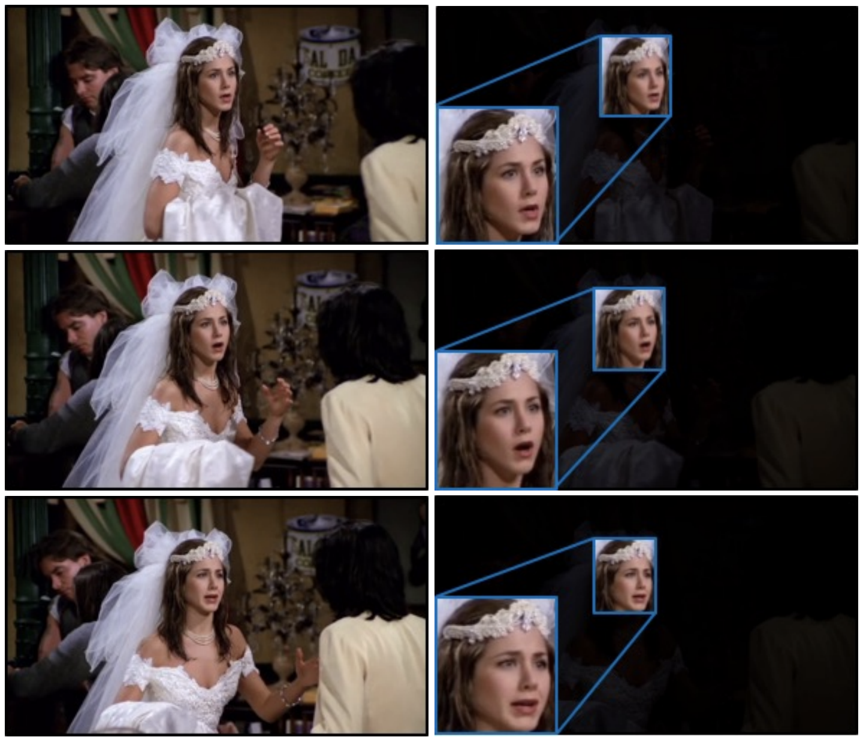
Approach – Introduction
Context & Face | Face only
Surprise | Anger
Surprise | Surprise
Surprise | Sad
Entire Context
Cropped Face

Slide 6
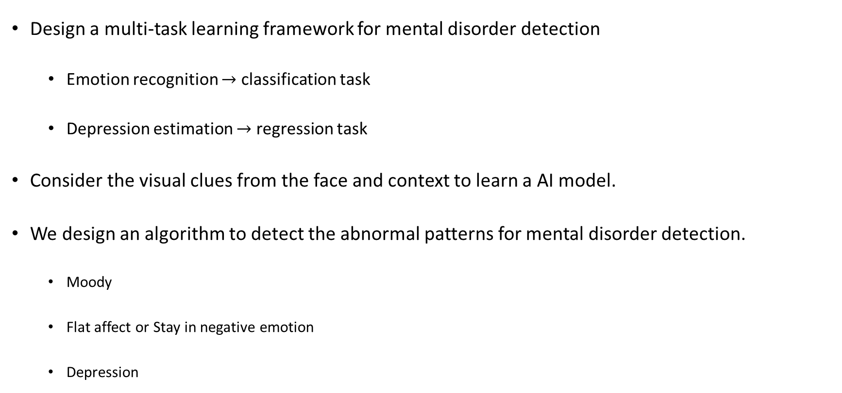
Approach – Introduction
Design a multi-task learning framework for mental disorder detection
Emotion recognition $→$ classification task
Depression estimation $→$ regression task
Consider the visual clues from the face and context to learn a AI model.
We design an algorithm to detect the abnormal patterns for mental disorder detection.
Moody
Flat affect or Stay in negative emotion
Depression

Slide 7
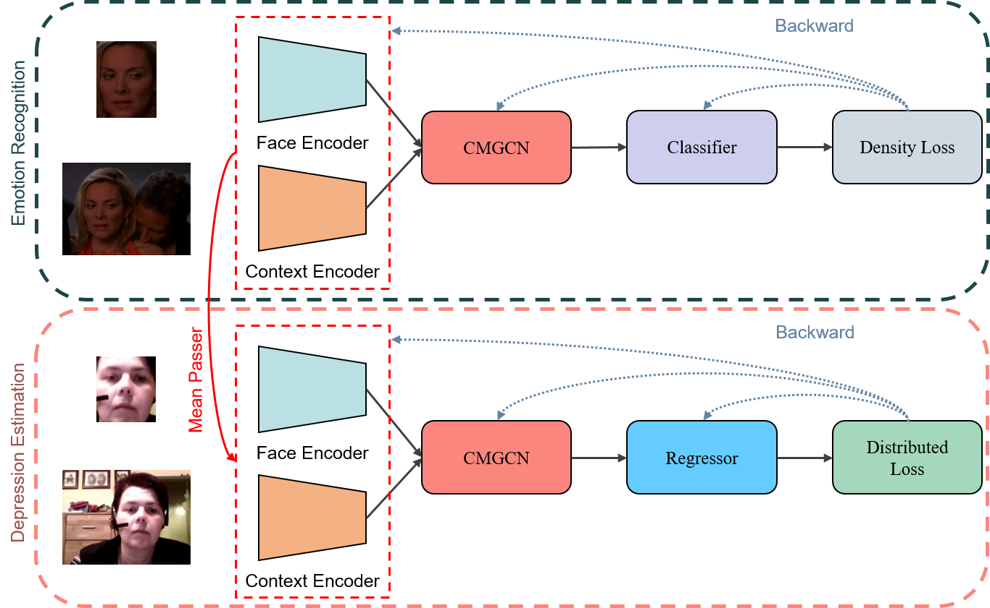
Approach – Multi-task learning framework

Slide 8
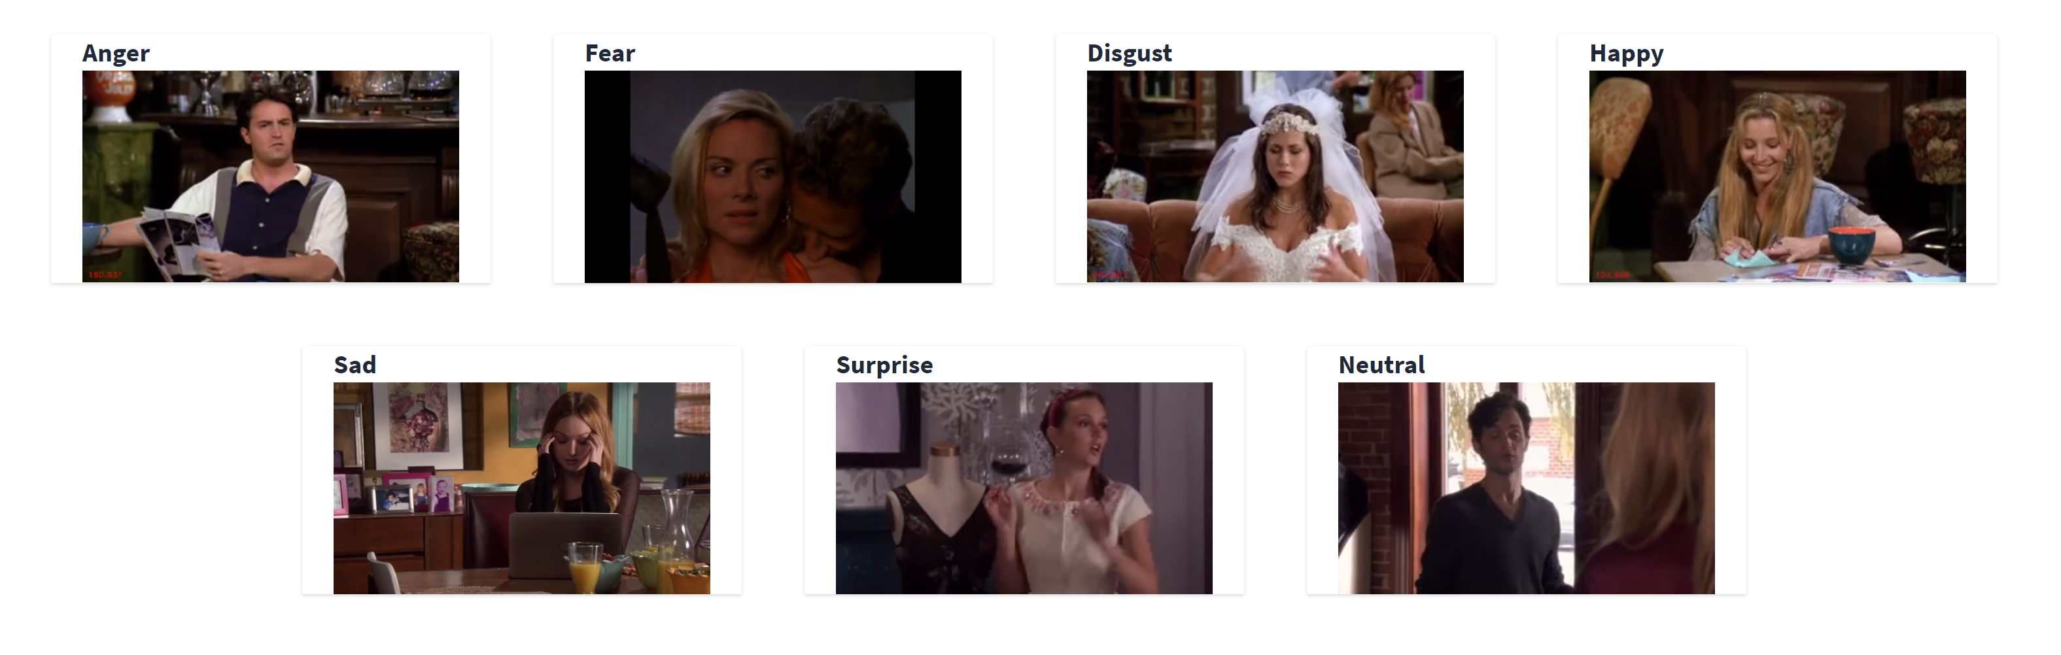
Approach – Multi-task learning framework
Emotion recognition:
Given a untrimmed video, the goal is to classify the emotional state with 7 discrete labels

Slide 9

Approach – Multi-task learning framework
Depression estimation:
Given a untrimmed video, the goal is to predict the depressive score with n levels
predict
BDI-II Score | Depression Severity
0 - 13 | None
14 - 19 | Mild
20 - 28 | Moderate
29 - 45 | Severe

Slide 10
Approach – Detection Algorithm
In cognitive science:
Emotion is defined as a state of readiness for the action when humans face stimulus events.
The duration of emotion is 0.05 to 0.5 seconds.
We constitute 16 frames (0.5 sec) as a video clip and adopt the prediction with 2 sec for analysis.

Slide 11
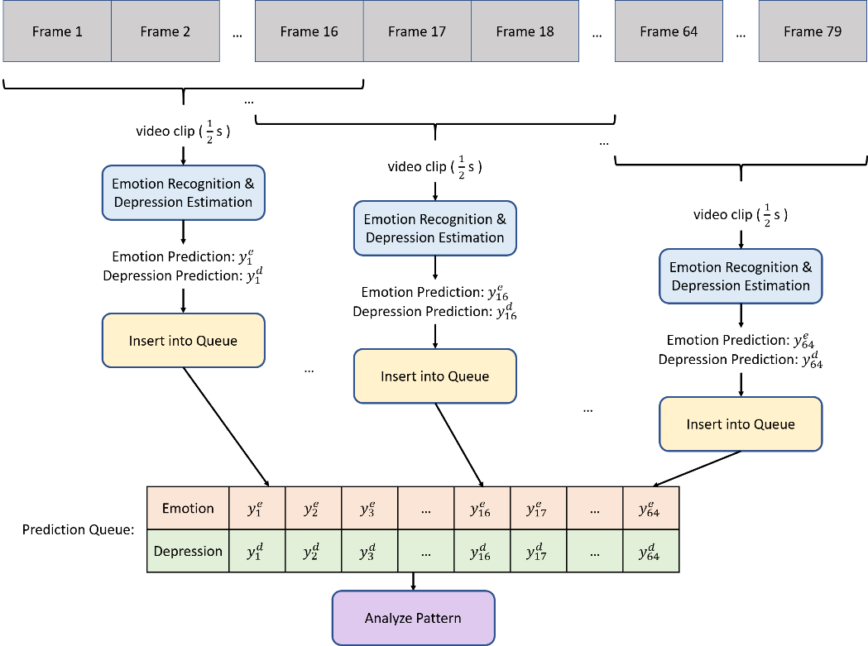
Approach – Detection Algorithm

Slide 12
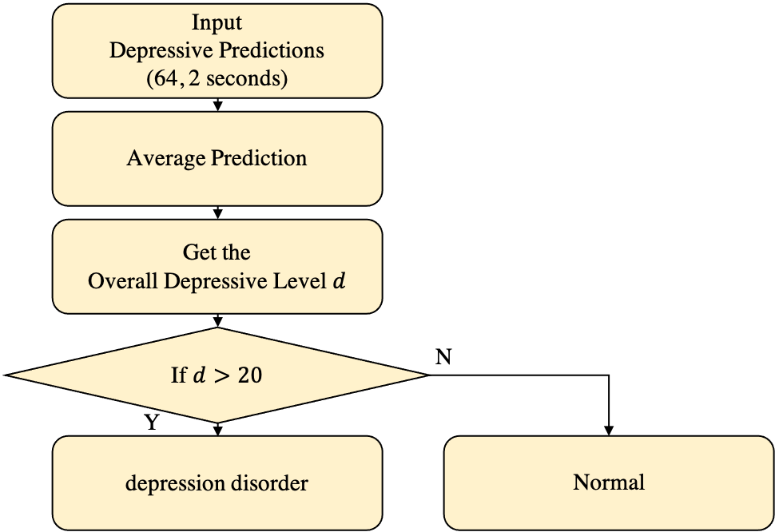
Approach – Detection Algorithm
For Depression disorder, we check the predicted depressive level.
Based on BDI-II Score
BDI-II Score | Depression Severity
0 - 13 | None
14 - 19 | Mild
20 - 28 | Moderate
29 - 45 | Severe

Slide 13
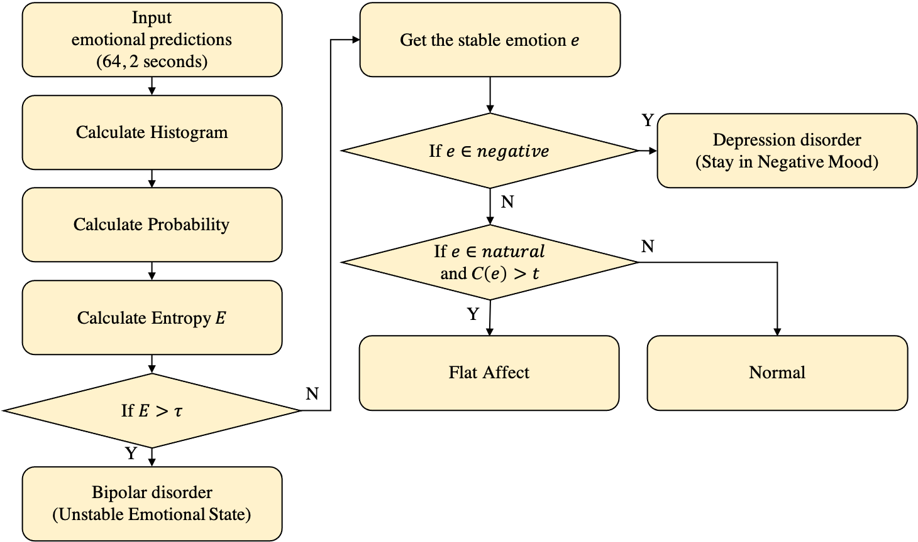
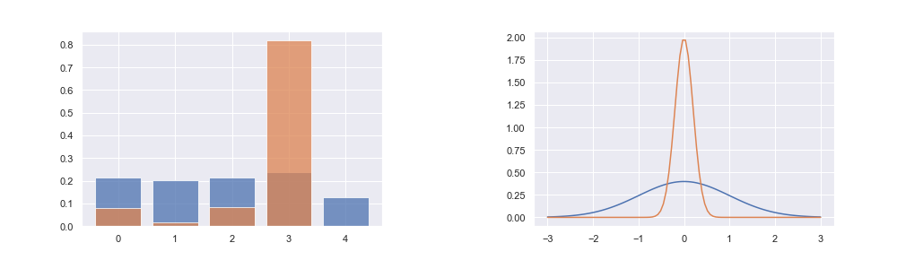
Approach – Detection Algorithm
Bipolar and Depression disorders, we analyze the predicted emotional status.
Calculate the Entropy of the prediction with 2 sec.
Blue: high entropy
Orange: low entropy

Slide 14
Results on public benchmarks
Results on Context-Aware Emotion Recognition
Method | Publication | Data type | Modality | CAER
 |  |  |  | Accuracy
Fine-tuned ResNet | CVPR’ 16 | Image | Face + Context | 68.46
CAER-Net-S | ICCV’ 19 | Image | Face | 70.09
 |  |  | Context | 65.65
 |  |  | Face + Context | 73.51
Fine-tuned C3D | ICCV’ 15 | Video | Face + Context | 71.02
CAER-Net | ICCV’ 19 | Video | Face | 74.13
 |  |  | Context | 75.57
 |  |  | Face + Context | 77.04
Ours | -- | Video | Face + Context | 87.23

Slide 15
Results on public benchmarks
Results on AVEC 14
Method | Publication | Data type | Modality | AVEC 14
 |  |  |  | MAE | RMSE
UUIMSidorov | AVEC’ 14 | Video | Face | 11.20 | 13.87
InaoeBuap | AVEC’ 14 | Video | Face | 9.35 | 11.91
Baseline | AVEC’ 14 | Video | Face | 8.86 | 10.86
Brunel | AVEC’ 14 | Video | Face | 8.44 | 10.50
BU-CMPE | AVEC’ 14 | Video | Face | 7.96 | 9.97
DCNN | TAC’ 18 | Video | Face | 7.47 | 9.55
RNN-C3D | TAC’ 18 | Video | Face | 7.22 | 9.20
Ours | -- | Video | Face + Context | 6.82 | 8.50

Slide 16
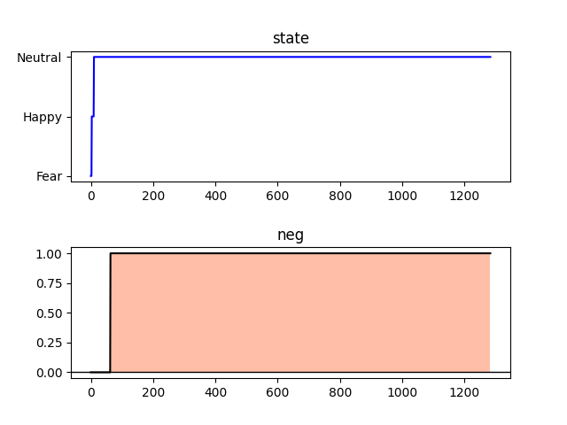
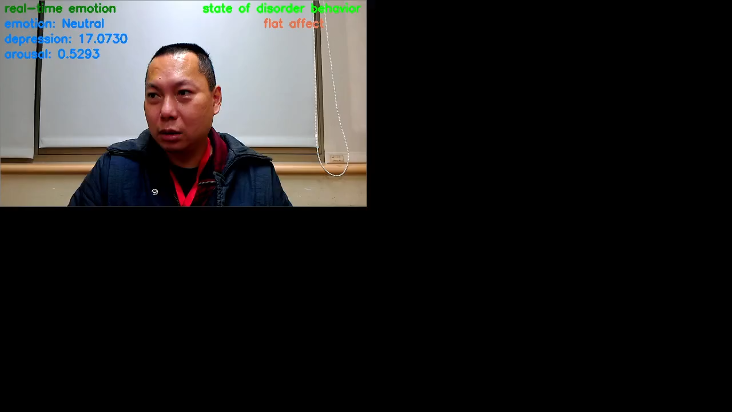
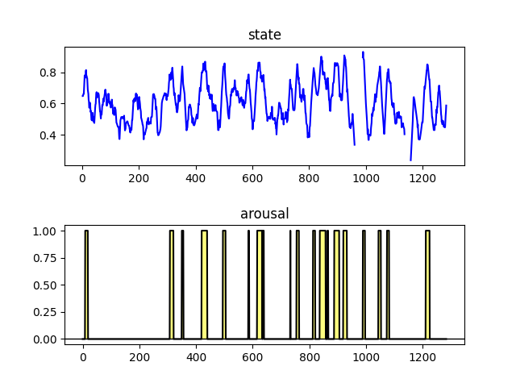
Demo Videos

Slide 17
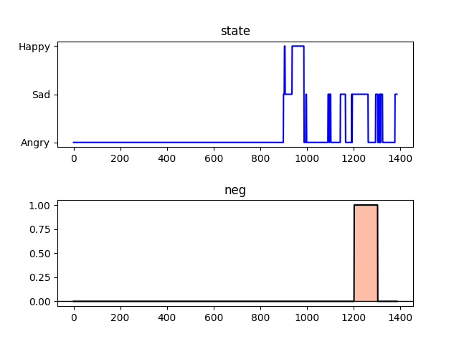
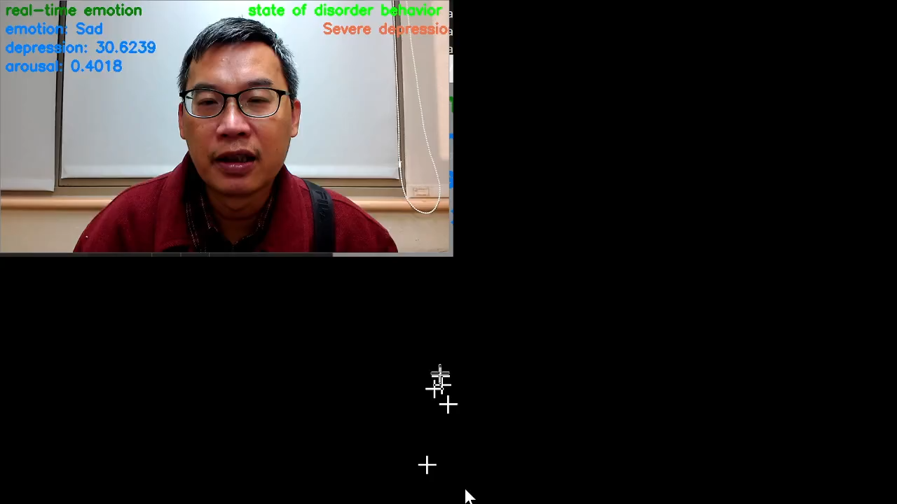
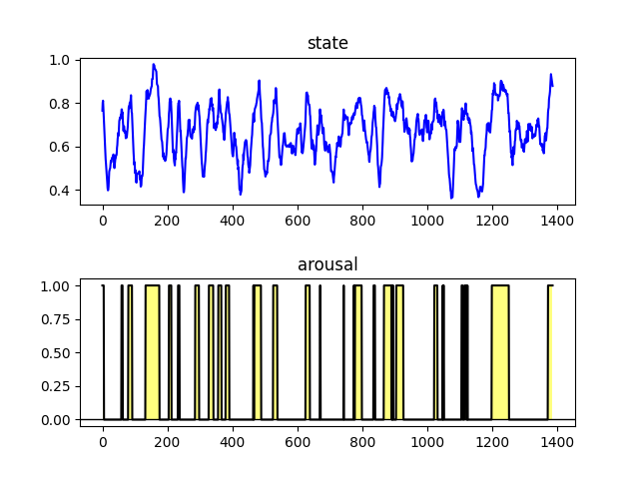
Demo Videos

